Slide 1



PREDICTING ACADEMIC SUCCESS OF UNDERGRADUATE DEGREE STUDENTS
Final Project
Presented by: Naina Gupta
Shivi Jain

Slide 2


CONTENT
01 Introduction
02 Problem Statement
03 Methodology
04 Data Cleaning
05 Data Visualization
07 Data Modelling
08 Findings and Recommendations
06 Feature Engineering

Slide 3
INTRODUCTION
DATA OVERVIEW:
Enrollment data for undergraduate degrees in various fields (UCI ML Repository)
36 variables, 4424 observations, Mix of numerical and categorical variables
'Target' variable with three classes: Dropout, Enrolled, Graduate
Factors Considered: Time of enrollment, student demographics, academic performance in the first and second semester, parents’ qualifications, and economic condition at course completion
OBJECTIVES:
Obtain insights on the observed data
Develop supervised machine learning models for predicting student academic success
Find factors affecting the odds of student dropout
Provide actionable recommendations.
Contribute to reducing higher education dropouts
OUTCOMES:
Empower higher education institutions with data-driven insights
Foster student success and retention through informed interventions
Reduce drop out rates of the institution under consideration

Slide 4



PROBLEM STATEMENT
USE CASE
Leveraging data, Python language and tools like Jupyter Notebook to explore the dataset, measure the predictive capacity of given factors with respect to the odds of a student’s academic success, and provide actionable recommendations
PROJECT GOAL
The final goal is timely identification of students at risk of dropping out at early stages of their academic path so that appropriate measures can be put in place to support them

Slide 5
METHODOLOGY
PROGRAMMING LANGUAGE: Python
TOOL: Jupyter Notebook
TECHNIQUES:
Data Cleaning (Pandas, Numpy)
Data Visualization (seaborn, Matplotlib)
Outlier Detection and treatment
Variable Encoding (OneHotEncoder, TargetEncoder)
Standardization (StandardScaler)
Supervised Machine Learning (sklearn functions)
Hyper-parameter tuning (GridSearchCV)
Cross- Validation

Slide 6
DATA CLEANING
No missing values in the dataset
12 unwanted columns identified for removal: Application order, application mode, non-evaluated curricular units and so on
Conversion of numerical-coded categorical variables to meaningful names:
Derived from the data dictionary
Enhanced data comprehensibility
Applied to variables like Marital status, Previous qualification, Course, Parents' qualifications and occupations, Nationality, Gender.

Slide 7
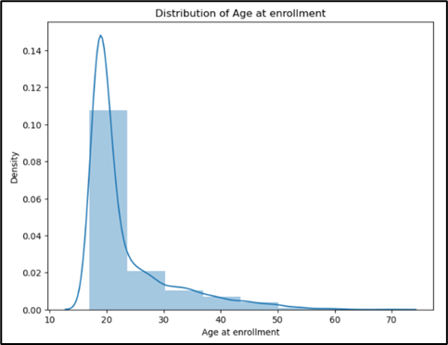
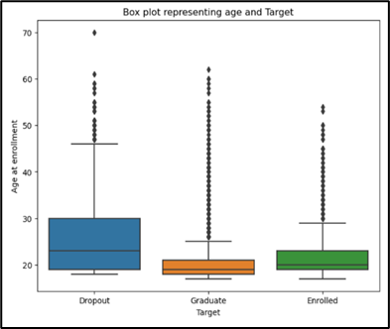
DATA VISUALIZATION
Student age at enrollment span from approximately 15 to 70 years.
Most undergraduate enrollments fall within the 18-22 years age bracket, typical for undergraduates.
Notably, the dataset includes enrolled students aged 60 and above, presenting a surprising range of age diversity.
Dropouts display a wider age range of 18 to 45 years.
Median age: 23 years.
Graduates' age is more concentrated between 18- 25 years.
Median age: 20 years.
Numerous outliers indicate that observations up to 60 years are typical, beyond that, exceptional.

Slide 8
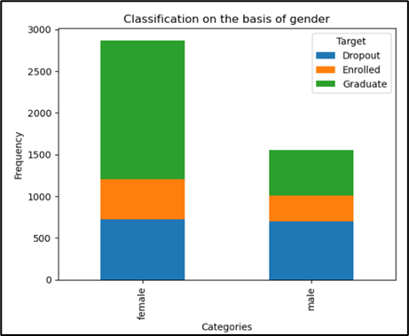
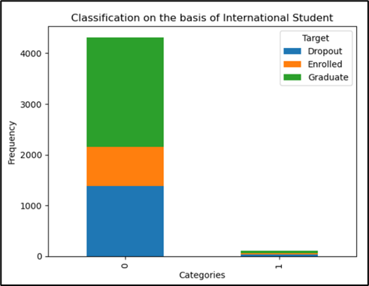
DATA VISUALIZATION
Bar graph illustrates more female students in the institution compared to males.
Gender doesn't significantly impact the dropout rate.
Proportion of dropouts is higher among males than females.
Bar graph highlights predominantly domestic students, with minimal international representation.
Skewed enrollment towards domestic students makes "International Status" column less relevant
Dropping this column is warranted for increased focus and accuracy.

Slide 9
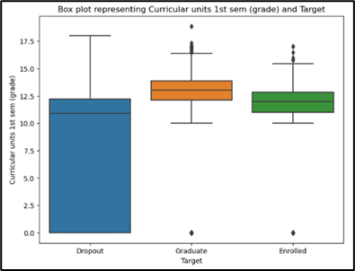
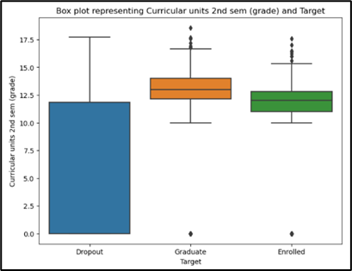
DATA VISUALIZATION
Dropout students consistently exhibit lower median grades compared to graduates and enrolled students
Larger grade variation observed among dropouts, highlighting inconsistency
Median grades for graduates surpass those of enrolled students, suggesting potential challenges or grading leniency in later semesters.
Visualization underscores the potential of initial semester grades as indicators of future academic success

Slide 10
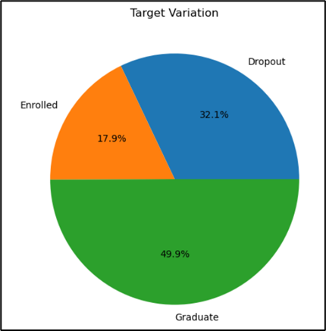
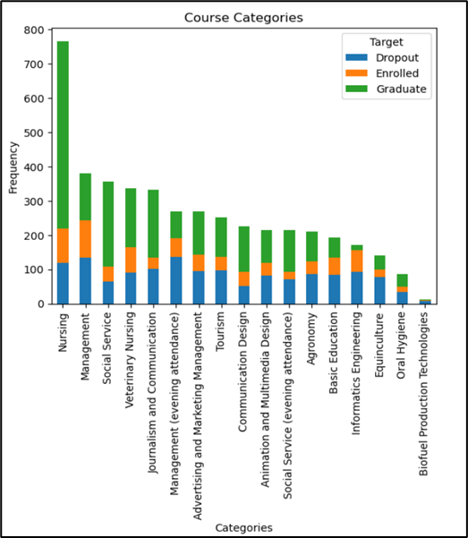
DATA VISUALIZATION
Significant skew towards 'Graduate' status.
High frequency of 'Graduate' class leads to model biases, favoring predictions of this class over others.
Biased data distribution might affect predictive accuracy, necessitating techniques to address class imbalance.
Chart shows prevalence of Nursing degrees, followed by Management, social service, veterinary nursing, and Journalism
Management degree displays notable dropout rate.
Animation/Multimedia Design, Agronomy, Basic Education, Informatics Engineering, Equinculture, Oral hygiene, Biofuel Production Technologies also exhibit dropout rates surpassing graduation rates.

Slide 11
FEATURE ENGINEERING
Binning and categorization:
Categorization of Mother's and Father's occupations and qualifications
Synchronization of columns by categorizing qualifications into groups to increase interoperability
Removal of records with student age > 70 as outliers
Binning age into 'child', 'adult', and 'senior' categories
Combining 'enrolled' and 'graduate' labels into 'non-dropouts’
Categorical Variable Encoding:
Label encoding for 'Target': '1' for 'dropout', '0' for 'non-dropout'
Target encoding for 'course category', 'Mother's occupation', and 'Father's occupation'
One-hot encoding for gender, marital status, age at enrollment, qualifications, and previous qualification
Numerical Data Standardization:
Standardization to rescale features to mean=0, std.dev=1 and prevent one feature from dominating others during training

Slide 12
Performance Summary of ML Models
Model Type | Accuracy | Predicted class | Precision | Recall | F1 score
Decision Tree Model | 86 | 1 | 84 | 70 | 76
Random Forest Model | 84 | 1 | 89 | 59 | 71
Gradient Boost Model | 87 | 1 | 85 | 70 | 76
XG Boost | 85.5 | 1 | 82 | 71 | 76
XGBoost (Hyper-tuned) | 87 | 1 | 87 | 69 | 77
Logistic Regression (Lasso) | 78.87 | 1 | 79 | 47 | 59
Logistic Regression (Ridge) | 78.98 | 1 | 79 | 47 | 59
SVM Model | 77.62 | 1 | 80 | 40 | 54
Hyper-tuned SVM Model | 77.62 | 1 | 80 | 40 | 54

Slide 13
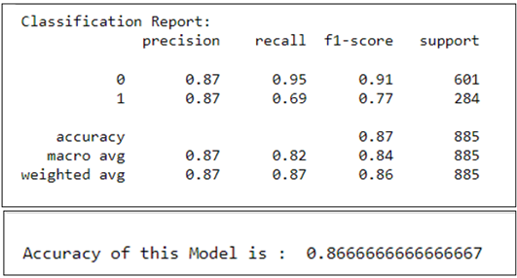
Hyper-tuned XG BOOST MODEL
XGBoost model performs better than the Random Forest model in case of class imbalance.
Intuitively, it makes model less biased by giving more weightage to less represented category of target variable.
We undertake K-fold Cross-validation to estimate performance of the XGBoost machine learning algorithm by training data on k folds rather than on just a single train-test set split.

Slide 14
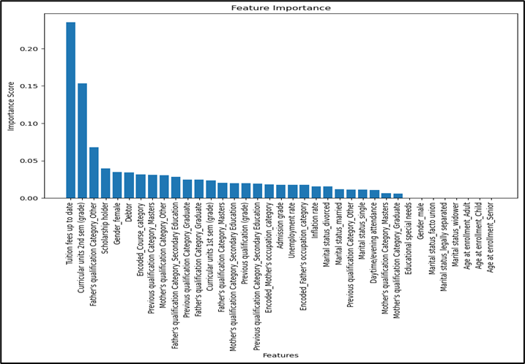
Hyper-tuned XG Boost Model
The below feature importance graph shows that the most important features are:
status of the tuition fee payment
curricular grade units for the second semester
father’s qualification

Slide 15
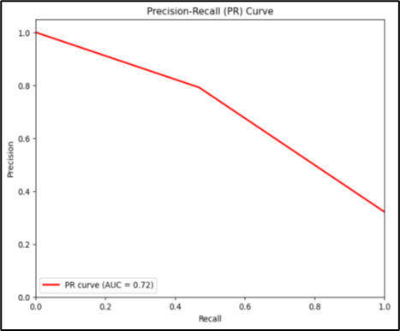
RIDGE REGRESSION MODEL
Since the instances of false negatives are very high, we choose Ridge regularized Logistic regression model with a higher recall value for the positive class
L2 regularization adds a penalty term based on the squared magnitudes of the coefficients to the cost function, helping prevent overfitting and improve generalization
Performance Metrics
Area Under the Curve (AUC) for ROC curve
Precision-Recall (PR) curve for imbalanced classification

Slide 16
RIDGE REGRESSION MODEL
On running L2 regularization on a standardized dataset with top 10 selected features selected by RFE technique, the major features whose per unit increase causes an increase in the odds of a student dropping out are:
course category
Mother’s occupation
previous qualifications of graduates
male gender
The features that lead to a decrease in the odds of a student dropping out with respect to a per unit increase in their value are:
paid-up tuition fee
Scholarship
age at enrollment

Slide 17

Data skewed towards successful graduates (50%), need to tackle data imbalances
Majority of students enroll between ages 18-22, yet notable instances of older students up to age 70 implying Age plays a role in tailored academic support and need to focus on challenges faced by adult learners
Economic conditions at graduation time are normal, No strong correlation between academic success and economic conditions
More female enrollees, but higher male dropout rate, Targeted support needed to address male dropout rates
First and second semester grades strongly predict overall success, so early academic support crucial to reduce failure and dropout rates
Out of all Ensemble models (Decision Tree, Random Forest, Gradient Boost, XG Boost) tested, Hyper-tuned XG Boost most reliable, achieves 87% accuracy, Addresses class imbalance, improves precision and recall
Curricular grade units, tuition fee status, father's qualification important
Since 1st and 2nd semester grades are impactful, early identification of at-risk students for timely intervention
Students with scores above 10 in curricular grades, up-to-date fee payments prone to dropout
FINDINGS
&
RECOMMENDATIONS

Slide 18
Course Category, Mother's Occupation, previous qualification of graduates and Male Gender were the most important features that increased the odds of a student dropping out.
Paid Tuition Fee, Scholarship, and Age at Enrollment were features that decreased the odds of dropout.
Targeted Intervention Programs for At-Risk Students can be implemented using academic counseling, mentorship, or additional support to help students overcome challenges specific to their backgrounds or course categories.
Since Up-to-date Tuition Fee and Scholarship holdings were found to decrease the odds of dropout, can consider offering more financial aid options, scholarships, or tuition fee assistance programs.
Reducing financial barriers for students who are legally separated or have family responsibilities, universities can provide additional support services tailored to their unique needs.
Since Male Gender was identified as a factor increasing the odds of dropout, universities can develop gender-specific support programs addressing challenges faced by male students and create a more inclusive and supportive environment to encourage their academic success.
Further investigation can be undertaken to assess how Mother’s occupation and Course category is affecting student’s academic success so that targeted interventions can be made.
FINDINGS
&
RECOMMENDATIONS

Slide 19
References
Dugar, D. (2023, May 13). Feature engineering in Python - towards data science. Medium. https://towardsdatascience.com/feature-engineering-in-python-part-i-the-most-powerful-way-of-dealing-with-data-8e2447e7c69e
GeeksforGeeks. (2022). Data Visualization with Python. GeeksforGeeks. https://www.geeksforgeeks.org/data-visualization-with-python/
Intro to Feature Engineering for Machine Learning with Python. (n.d.). https://www.learndatasci.com/tutorials/intro-feature-engineering-machine-learning-python/
Plotly. (n.d.). https://plotly.com/python/
Python, R. (2023). Pythonic Data Cleaning With pandas and NumPy. realpython.com. https://realpython.com/python-data-cleaning-numpy-pandas/
UCI Machine Learning Repository. (n.d.). https://archive.ics.uci.edu/dataset/697/predict+students+dropout+and+academic+success
GeeksforGeeks. (2021). Histograms and Density Plots in Python. GeeksforGeeks. https://www.geeksforgeeks.org/histograms-and-density-plots-in-python/
GeeksforGeeks. (2022a). Box Plot in Python using matplotlib. GeeksforGeeks. https://www.geeksforgeeks.org/box-plot-in-python-using-matplotlib/
GeeksforGeeks. (2022b). Plotting Correlation Matrix using Python. GeeksforGeeks. https://www.geeksforgeeks.org/plotting-correlation-matrix-using-python/
Maklin, C. (2022, May 9). K Nearest Neighbor Algorithm In Python - Towards Data Science. Medium. https://towardsdatascience.com/k-nearest-neighbor-python-2fccc47d2a55

Slide 20
THANK YOU

